Slide 1
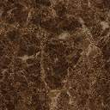


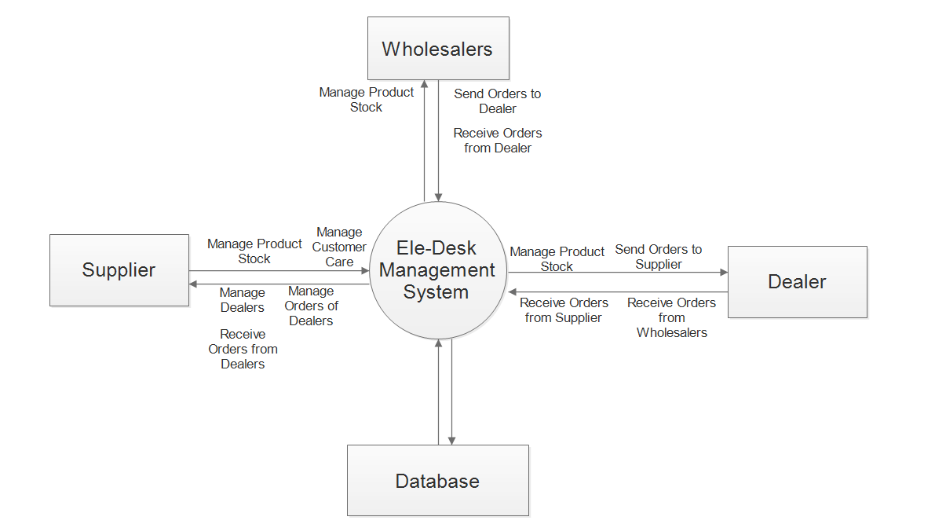
C. U. SHAH (GOVT) POLYTECHNIC
SURENDRANAGAR
COMPUTER ENGINEERING DEPARTMENT
Topic : Ele-Desk
ABSTRACT
“Ele-Desk” project is a supply or sharing of resources between a Admin, a Dealer and a Wholesaler. There are a lot of products manufactured by the company “Zell Electronics” like laptop, TV’s and mobiles etc. The Admin will be the main supplier of the products. The Dealers will place the orders to the Admin, and Wholesalers will place the orders to Dealers. Once they place the order, they will get the discount according to their purchases. “Ele-Desk” is for resolving the problem of offline purchases and with this, we can make online order which helps in saving time and making additional charges like travelling to the Admin.
INTRODUCTION
Our project “Ele-Desk”, revolutionizes the traditional offline order process.
By using our website, Dealers and Wholesalers will be able to place order online and because of this they will save a lot of time and money. Our project will make it easy to place order online.
We have used HTML,CSS and Java Script in frontend. PHP in backend and MYSQL as database tool.
Using our project the Dealers and Wholesalers are able to easily place the order to the Admin.
This will save a lot of time and money of Dealers and Wholesalers
REQUIREMENTS
SCOPE
Laptop/Computer with at least 2GB Ram and Pentium processor.
Mobile at least of 5.0 android version.
Good Internet Connectivity.
User must know how to use laptop/computer/mobile.
BLOCK-DIAGRAM
CONCLUSION
Our project has taught us valuable lessons about the importance of team management, team collaboration and project management. The traditional way of placing orders offline and losing time and money has been completely resolved by our project. This project will be beneficial to all mid range businesses to higher level businesses.
Prepared By -
Jimit .S. Dagli (206090307002)
Vishal .R. Parmar (206090307031)
Sumeet .K. Kapadia (206090307059)
Tirth .M. Doshi (206090307063)
Guided By –
Mr B.D. Limbasiya
(Lecturer – Computer Engg. Dept.)

